Slide 1
Year 1 – Relativity
Lecture 2
Paul Dauncey

Slide 2
Overview of lectures
Lecture 1: Introduction, concepts and classical results
Lecture 2: The postulates of Relativity
Lecture 3: Length contraction and simultaneity
Lecture 4: The Lorentz transformations
Lecture 5: Space-time diagrams and world lines
Lecture 6: Four-vectors and causality
Lecture 7: Energy and momentum
Lecture 8: Energy and momentum conservation
Lecture 9: Particle reactions
Lecture 10: The relativistic Doppler effect

Slide 3

Previously on Relativity
Looked at transformations between different coordinate measurement “frames”
  Saw rotations and Galilean transformations
  (Apologies: rotation angle definition wrong!)
  Galilean speed transformation: u’ = u - v
If the transformations correspond to a symmetry of physics
  All observers must agree on what happened
  Physical laws (e.g. Newton) must hold in all frames
  There is no way to define an “absolute” coordinate frame
3

Slide 4
What we will do today
See how Maxwell’s equations are not consistent with the Galilean transformations
  Maxwell’s equations give a fixed speed for light
  Appear to break the symmetry of Galilean frames
Discuss the Michelson-Morley experiment
  Failed to find any lack of a symmetry
Present the postulates of Relativity
  Assumes the symmetry is true, but Galileo is wrong
See our first result derived from the postulates
  Time dilation
4

Slide 5
Analogy with sound
Sound travels in a medium (i.e. air) with a fixed speed
  If we do an experiment with no wind, sound travels at same speed in all directions
But if there is a wind relative to the fixed experimental apparatus
  Sound travels faster than expected in wind direction
  And slower in the opposite direction
5

Slide 6
Maybe light has a medium?
The assumed medium for light was called the “aether” (or “ether”)
  Must occupy all space, including in vacuum
If the Earth is not moving through the aether
  Light will have a constant speed in all directions
But if the Earth is moving through the aether
  Light speed will depend on direction
The aether stationary (“rest”) frame is special
  You can tell you are in this inertial frame
  This breaks the inertial frame symmetry
6

Slide 7
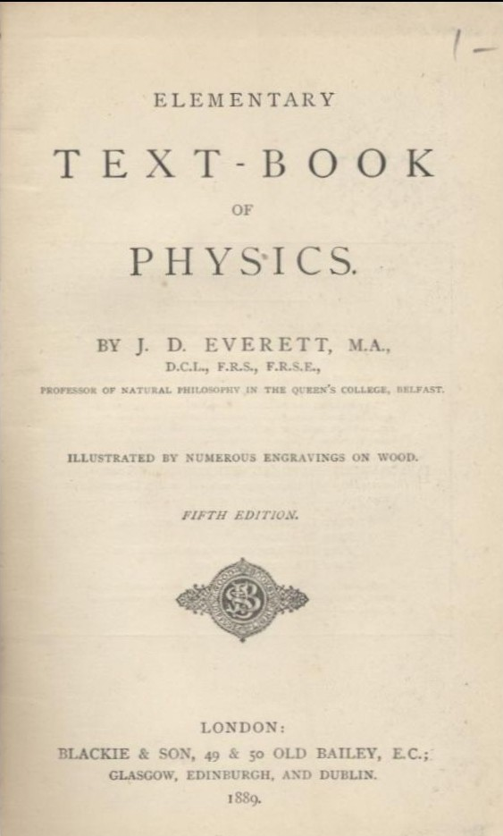
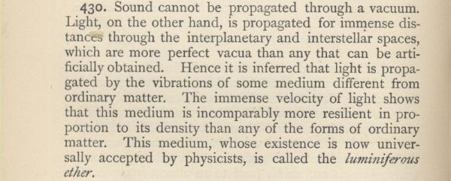
The aether was a fact...
7

Slide 8
The Michelson-Morley experiment
Aether

Slide 9
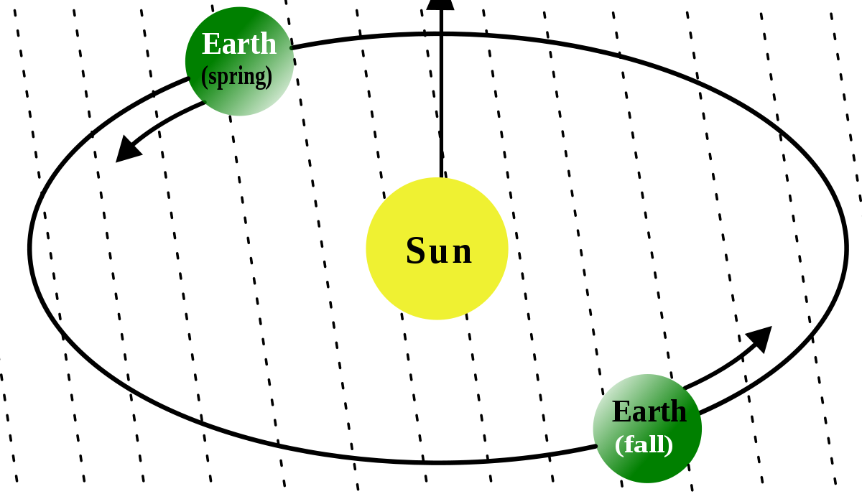
Rotate the whole experiment
Aether
Aether
Still no shift seen
No shift seen

Slide 10
The postulates of Relativity
There are only two postulates = assumptions
  The laws of physics are the same in all inertial frames, i.e. coordinate frames moving uniformly relative to each other
  The speed of light c in vacuum is independent of the speed of the light source and has the same value for all inertial observers
No violation of the postulates has ever been seen experimentally
10

Slide 11

The all-seeing observer
y
x

Slide 12


Relative motion
Rashid is a traffic cop at Rest by a hyperway
Sam is Superfast going at 2.9×10⁸ m/s
Beth is light Beam emitted by Sam
Go to www.menti.com and enter code 15 37 34
Question 1: What speed does Rashid observe Beth moving at?
Question 2: What speed does Sam observe Beth moving at?
Question 3: What speed does Sam observe Rashid moving at?
12

Slide 13
Relative motion
Qus 1&2: Rashid and Sam both see Beth moving at c = 3.0×10⁸ m/s
  The second postulate says this must be true
Qu 3: Sam sees Rashid moving at −2.9×10⁸ m/s
  If they did not agree on their relative speed, there would have to be some other difference between the two frames
  But the first postulate says all inertial frames are equivalent
13

Slide 14
A stationary light clock
Mirror
1
0
2
3
4
5
Light pulse emitter and detector

Slide 15
A moving light clock
0
1
2
3
4
5
0
1
2
3

Slide 16
A moving light clock
0
1
2
3
4
5
0
1
2
3

Slide 17
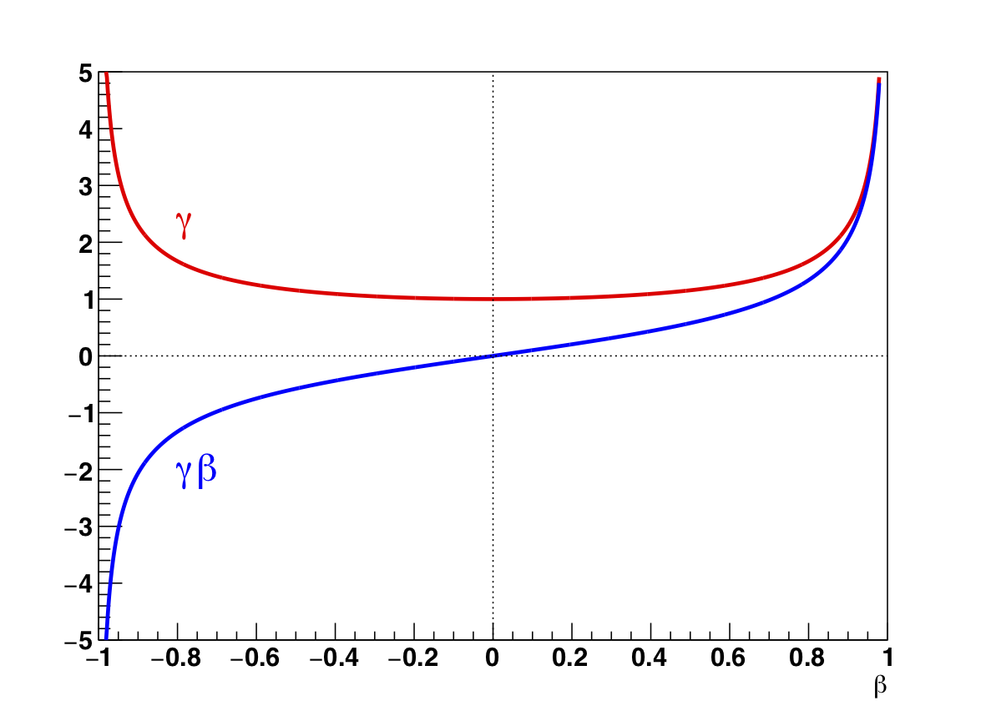
γ and γβ vs β
17

Slide 18




Comparing clocks
1
0
2
3
4
5
AND gate
Danger:
High Voltage
1
0
2
3
4
5

Slide 19
Works both ways
All inertial frames are equivalent
  Rashid sees Sam’s clock slow run slower than his watch
  Sam sees Rashid’s watch run slower than his clock!!!
19

Slide 20


The twins “paradox”
Ali and Ed are twins
  Ali goes to Alpha Centauri, Ed stays on Earth
Ed sees Ali’s time runs slowly when moving
  On the way out and back
  She is younger than him when she returns
Why doesn’t Ali see Ed get younger than her?
20

Slide 21
What we did today
Saw that Maxwell’s equations predict a constant speed of light
  Requires the Galilean transformations to be modified
Presented the postulates of Relativity
  All inertial frames are equivalent
  The speed of light is constant for all observers
Saw our first result derived from the postulates
  Time dilation; time for an object slows down when it is moving by a factor of γ = 1/√[1-(v/c)²]
21

