Slide 1
Year 1 – Relativity
Lecture 4
Paul Dauncey

Slide 2
Overview of lectures
Lecture 1: Introduction, concepts and classical results
Lecture 2: The postulates of Relativity
Lecture 3: Length contraction and simultaneity
Lecture 4: The Lorentz transformations
Lecture 5: Space-time diagrams and world lines
Lecture 6: Four-vectors and causality
Lecture 7: Energy and momentum
Lecture 8: Energy and momentum conservation
Lecture 9: Particle reactions
Lecture 10: The relativistic Doppler effect

Slide 3
Previously on Relativity
Saw the postulates of Relativity
  All inertial frames are equivalent
  The speed of light c is the same for all observers
Saw that the Galilean transformations must be only approximations
  u’ = u –v is not exact
  Specifically, there must be some other relativistic transformations which reduce to the Galilean ones for low speeds
3

Slide 4
Clarification
A wave equation for the E (or B) fields can be derived from Maxwell’s equations in vacuum
  Gives wave speed c = 1/√ε₀μ₀
The subscript 0 indicates the values are the permittivity and permeability in vacuum
  Hence c is also the speed in vacuum
  Light speed in materials is given by c/n where n is the refractive index
Throughout Relativity, we only consider the speed in vacuum: c is a constant
4

Slide 5
What we will do today
Discuss the concept of an event
  A coordinate point in space and time
Introduce the Lorentz transformations
  The exact transformations in Relativity
Check they are consistent with the postulates
  The speed of light must not be changed by the transformations
See how velocities transform between frames
  They must also give the Galilean transformations in the low speed approximation
5

Slide 6

The concept of an “event”
Not what I mean by an “event” in reality...
Not what I mean by an “event” in relativity...
6

Slide 7
The concept of an “event”
For rotations we dealt with a position x,y
  When we do a rotation, we get new values x’,y’
An event is just a “position” in space and time
  In principle t,x,y,z (but will often drop y and z)
  When we change frames, we get new values t’,x’
  Ideally an event = infinitesimally small point in space at an instant in time (or some approximation…)
An event can be a considered both as
  A position in space-time
  Something happening at a particular time and place
7

Slide 8
Menti question 1
Go to www.menti.com and enter 55 60 92
How many “interesting” events are happening this asymmetric double light clock?
Light pulse emitter and detector
1
1
0
0
Mirror
Mirror

Slide 9
Menti answer 1
Mirror
Mirror
There are 5 events
  Both light pulses are emitted
  Left pulse hits mirror
  Right pulse hits mirror
  Left pulse reaches centre
  Right pulse reaches centre

Slide 10
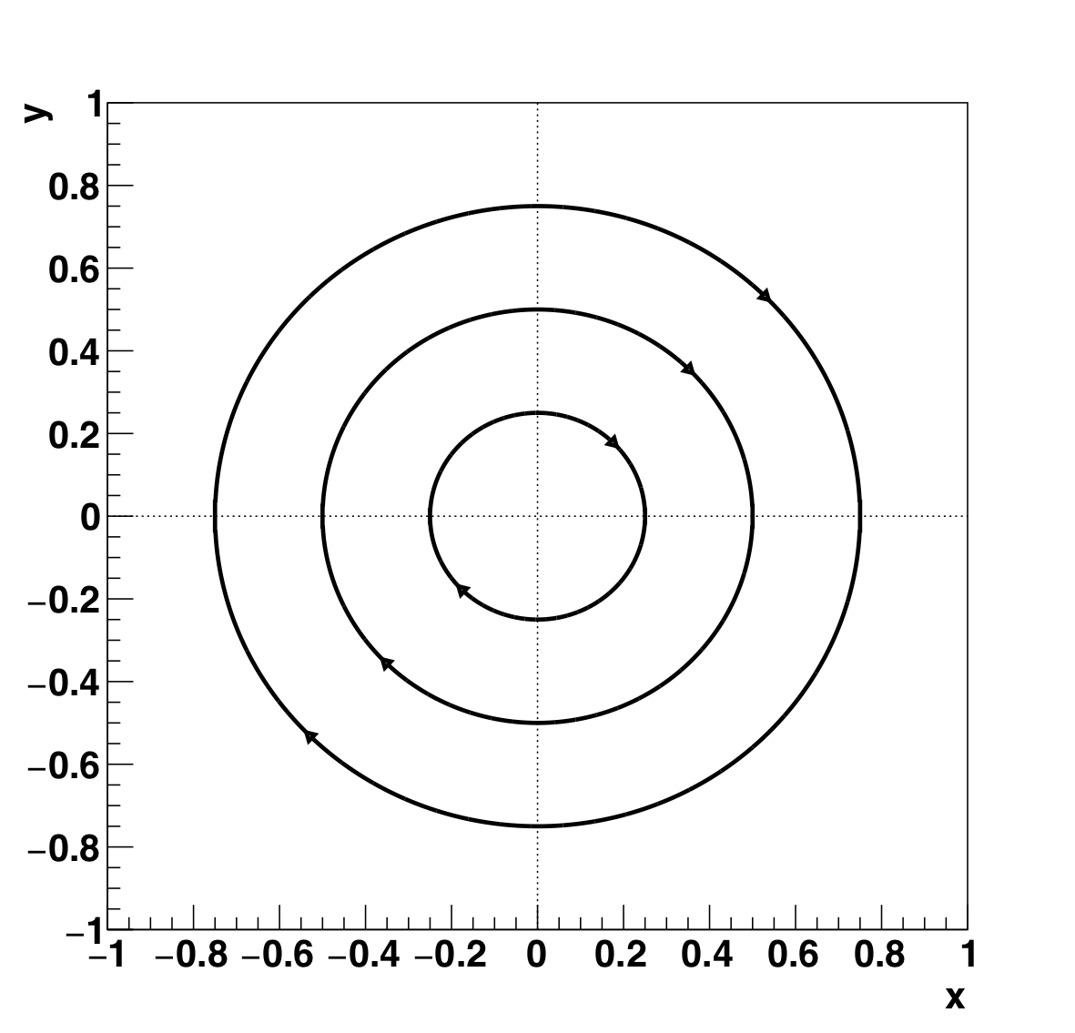
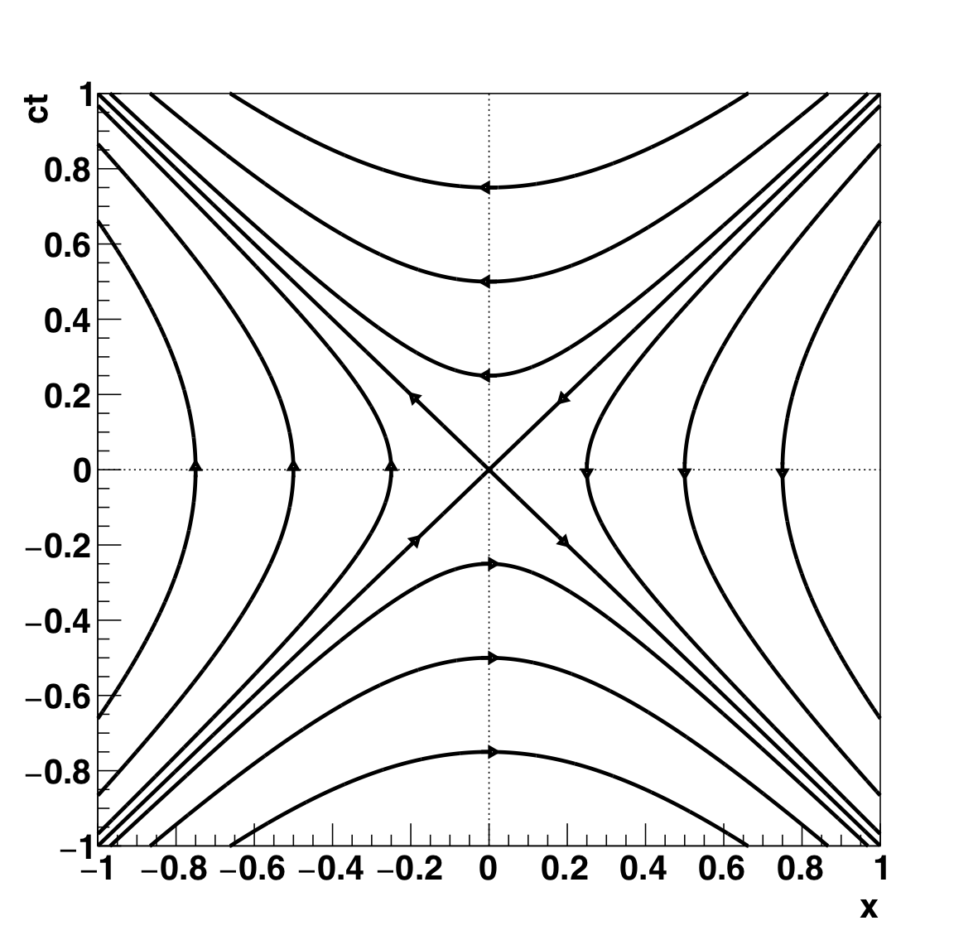
Changes to coordinates/events
Rotations
Lorentz transformations
10

Slide 11
Menti question 2
Go to www.menti.com and enter 55 60 92
Consider two simultaneous events in frame 1
  At x₁=0,ct₁=0 and x₂=1,ct₂=0
Consider a transformation to frame 2
  Moving at β=3/5 so γ=5/4
What is the time difference of the events in frame 2?

Slide 12
Menti answer 2
We only need to find the times in frame 2
For x₁=0,ct₁=0
  ct₁’ = (5/4) [0 − (3/5) 0] = 0
  0,0 always transforms to 0,0
For x₂=1,ct₂=0
  ct₂’ = (5/4) [0 − (3/5) 1] = −(5/4)(3/5) = −3/4
Time difference is 3/4c
  Not simultaneous in frame 2

Slide 13
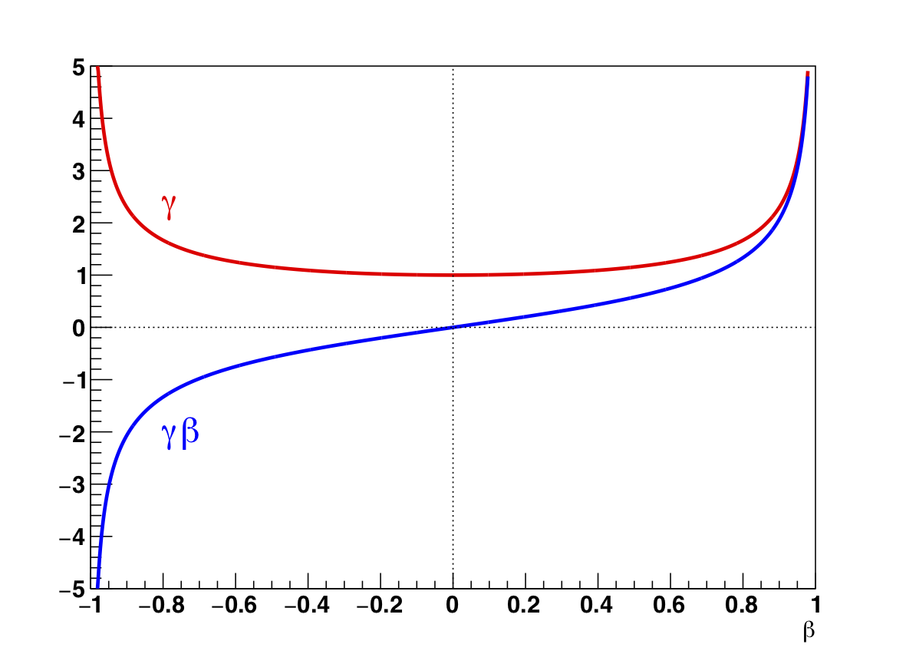
γ and γβ vs β

Slide 14
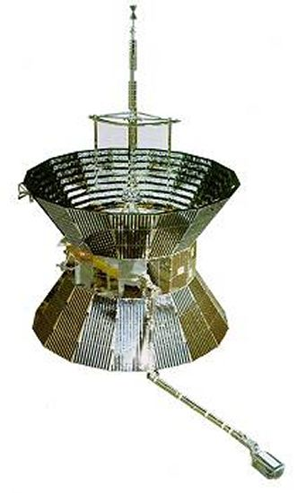

How big is Δt = t’-t?
Fastest man-made object: Helios 2 space probe achieved 360,000 km/h ~ 100 km/s ~ 3×10⁻⁴ c
For an experiment the size of the Earth and some of its apparatus going as fast as Helios 2, Δt ~ 10 μs
Light takes 0.04s to cross the world
~13000 km

Slide 15
Is the speed of light constant?
Light pulse emitter and detector
Mirror
Event 2: light hits mirror
t₂=t, x₂=ct
Event 1: light emitted
t₁=0, x₁=0
15

Slide 16

What about other speeds?
Spaceship base
Spaceship speed u
Earth
Event 2: spaceship reaches Earth
t₂=t, x₂=ut
Event 1: spaceship leaves base
t₁=0, x₁=0
16

Slide 17
Example: velocity transformation
An observer on Earth sees two spaceships approaching from opposite directions
  Spaceship 1 is coming at β_{u1} = 3/4
  Spaceship 2 is coming at β_{u2} = −1/2
  For observer on Earth, their relative velocity is 3c/4+c/2 = 5c/4 i.e. more than the speed of light
  But no individual object is moving at speed > c so this is allowed in the Earth’s frame
What speed does spaceship 2 appear to be moving for an observer on spaceship 1?

Slide 18
What we did today
Saw the concept of an event
  A coordinate point in space and time
Introduced the Lorentz transformations
  Move an event from t,x to t’,x’
  Cleanest to express as ct,x
  They also give the Galilean transformations in the low speed approximation
Saw how velocities transform
  The speed of light is not changed
  This also approximates to Galilean transformations
18

