Slide 1
Year 1 – Relativity
Lecture 6
Paul Dauncey

Slide 2
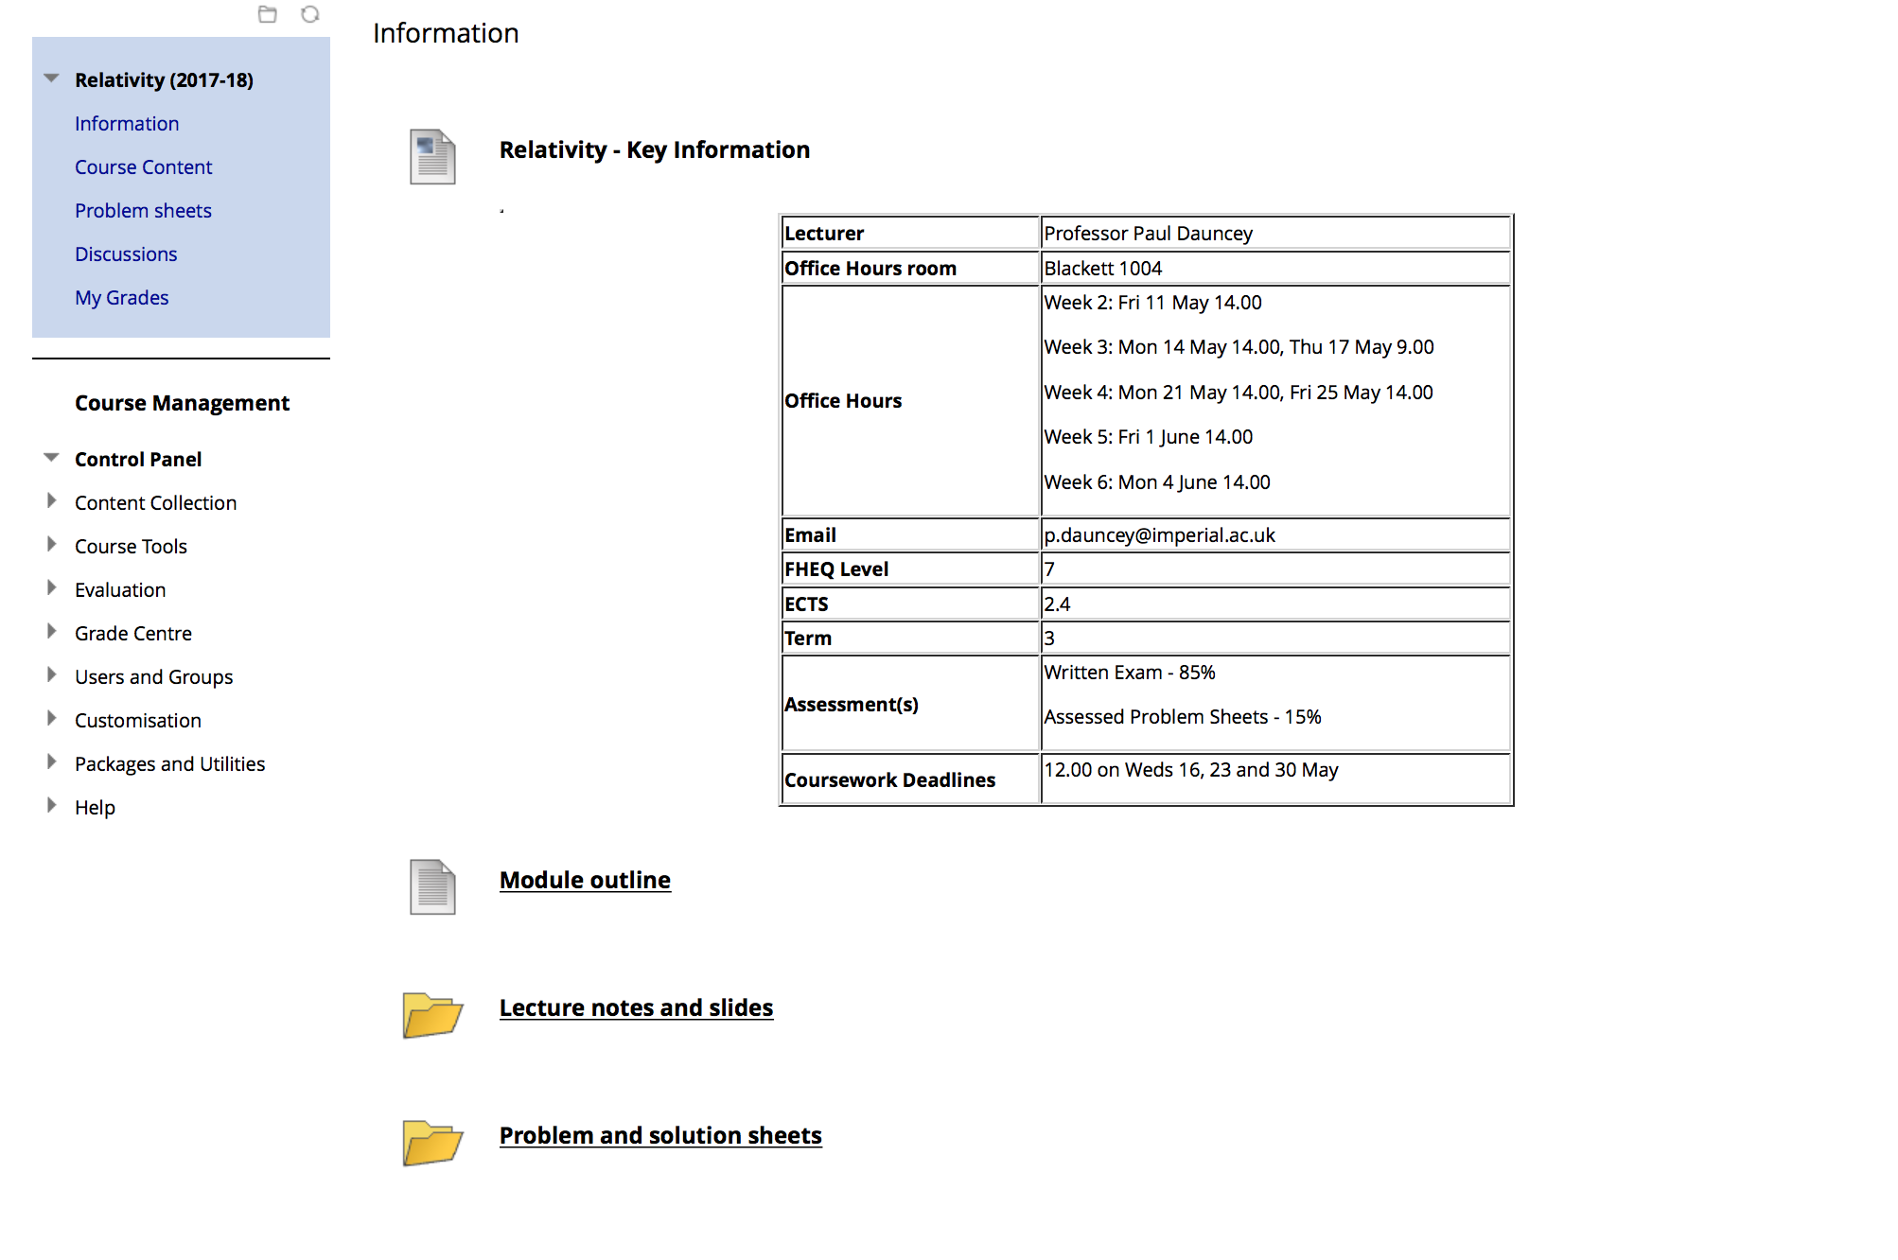
Organisation

Slide 3
Overview of lectures
Lecture 1: Introduction, concepts and classical results
Lecture 2: The postulates of Relativity
Lecture 3: Length contraction and simultaneity
Lecture 4: The Lorentz transformations
Lecture 5: Space-time diagrams and world lines
Lecture 6: Four-vectors and causality
Lecture 7: Energy and momentum
Lecture 8: Energy and momentum conservation
Lecture 9: Particle reactions
Lecture 10: The relativistic Doppler effect

Slide 4
Previously on Relativity
Saw events and Lorentz transformations
  Events move under Lorentz transformations in ct,x space in an equivalent way to rotations in x,y space
  Saw that nothing can go faster than light as the expression for γ becomes imaginary
Also discussed simultaneity
  Events which are simultaneous in one frame are not simultaneous in any other frame unless they are at the same position as well; i.e. effectively the same event
4

Slide 5
What we will do today
Introduce four-vectors
  Similar concept to “normal” vectors but with four components
  See that the length squared of all four-vectors is constant under Lorentz transformations
Discuss the separation of two events
  Separation = the length squared of the four-vector which gives the difference of the two events
  The sign of the separation is a critical value
  Discuss how this relates to causality
5

Slide 6
Four-vector notations
The space-time four-vector (“four-position”)
  I will write as (ct,r) = (ct,x,y,z)
  Similar to writing the three-vector r = (x,y,z)
  Some books use uppercase bold/underlined but ambiguous with some three-vectors; e.g. E
The components can also be numbered
  For any three-vector a, can write a = (a₁,a₂,a₃)
  The “extra” component in four-vectors is numbered 0
  Hence writing (ct,r) = (x⁰,x¹,x²,x³) is very standard notation but a bit confusing when you first see it so not used in this course
6

Slide 7
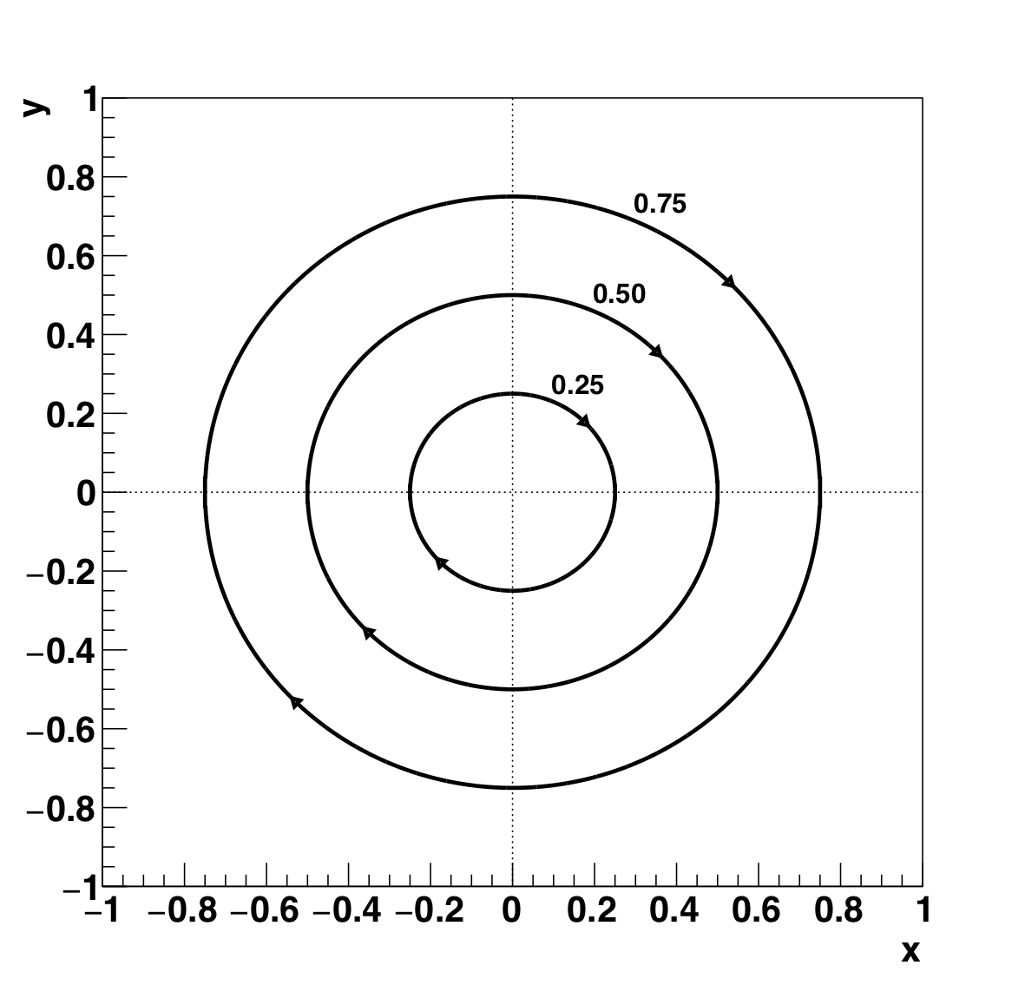
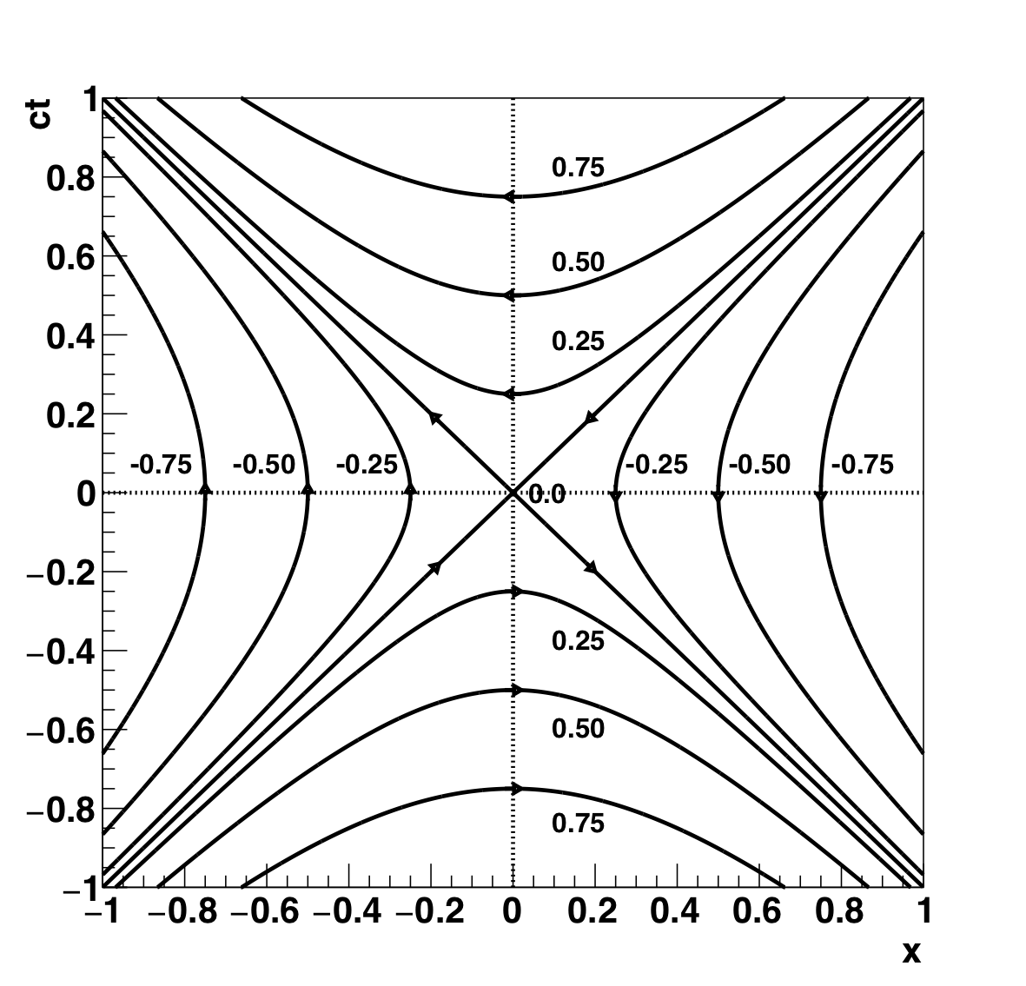
Lines of constant length-squared
Rotations
Lorentz transformations
S² can be >0, =0 or <0
7

Slide 8
Length-squared notations
Four-position length-squared S² = c²t² − r²
  We will treat the negative sign as simply something we have to remember
  Some (usually older) books define it as r² − c²t²
  Some define four-vectors to include an imaginary time component (ict,r); squaring and adding all four components gives r² − c²t² automatically
General Relativity generalises this
  Components multiplied by a “metric” (+1,−1,−1,−1)
  These value change in gravitation fields so the ict idea is a bit of a dead end
8

Slide 9
Distance between space points
Δr’
Δr
Rotate by 60º
r₂
r’₂
r’₁
r₁
r₂ = r₁ + Δr so Δr = r₂ − r₁
60º
Δr rotates like any other vector so length is invariant
Redefine origin to be at r₁
Δr
Δr’
9

Slide 10
Menti question
Go to www.menti.com
Enter code 52 79 16
Question 1: A proper time between two events can be defined for
  Any two events
  Only two events with ΔS² > 0
  Only two events with ΔS² = 0
  Only two events with ΔS² < 0
10

Slide 11
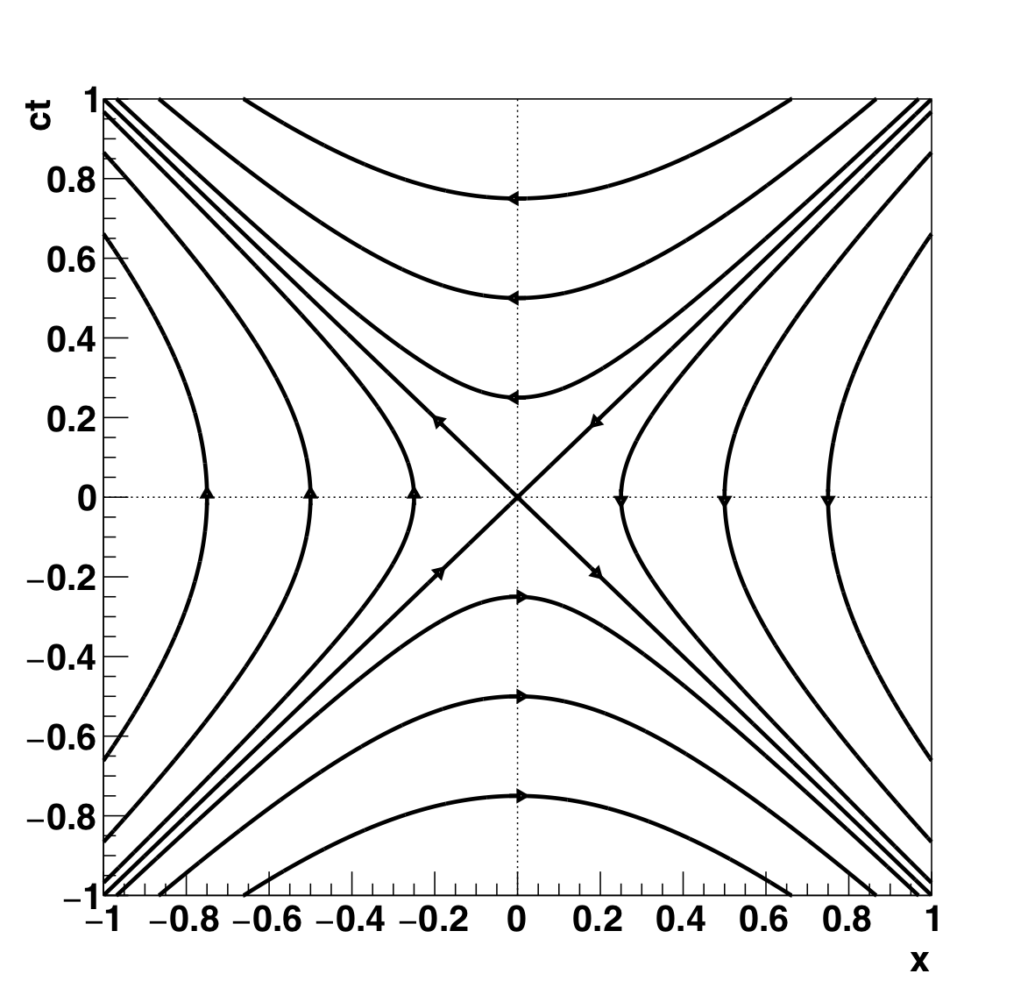
Separation with event 1 at origin
ΔS² = 0
ΔS² = 0
ΔS² > 0
ΔS² < 0
ΔS² < 0
ΔS² > 0
ΔS² = 0
ΔS² = 0
11

Slide 12

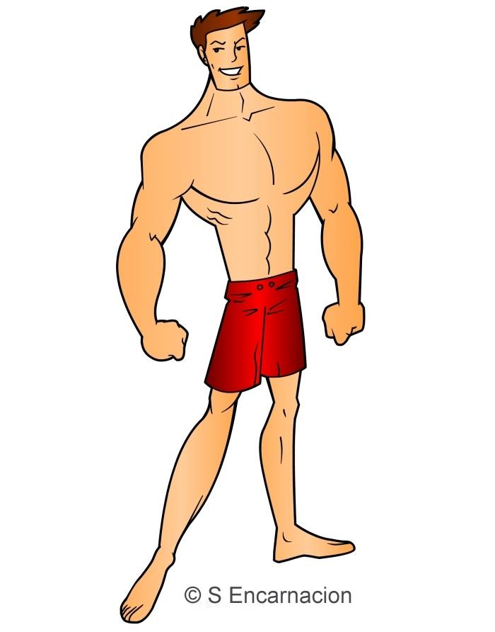

Can one event affect another?
ct
?
x
Event 1: I throw the heavy weight
Event 2: Puppy gets squashed
12

Slide 13
When can I throw the weight?
ct
cΔt < Δx i.e. ΔS² < 0 Puppy survives
x
Speed = c
cΔt ≥ Δx i.e. ΔS² ≥ 0 Puppy gets squashed
High speed
Low speed
13

Slide 14
The light-cone
ct
Inside
1
0
x
2
Inside
14

Slide 15
Events within light-cone
Time difference always positive in every frame
Can affect
Time difference always negative in every frame
Can affect
15

Slide 16
The light-cone
ct
Inside
1
3
Outside
0
Outside
x
4
2
Inside
16

Slide 17
Events outside light-cone
Cannot affect
Time difference can be positive or negative in different frames
Time difference can be positive or negative in different frames
Cannot affect
Cannot affect
17

Slide 18
Menti question
Go to www.menti.com
Enter code 52 79 16
Question 2: Two events with exactly ΔS² = 0 are causally connected
  True
  False
18

Slide 19
Menti question
Go to www.menti.com
Enter code 52 79 16
Question 3: For any event, the space-time “volumes” inside and outside its light-cone are equal
  True
  False
19

Slide 20
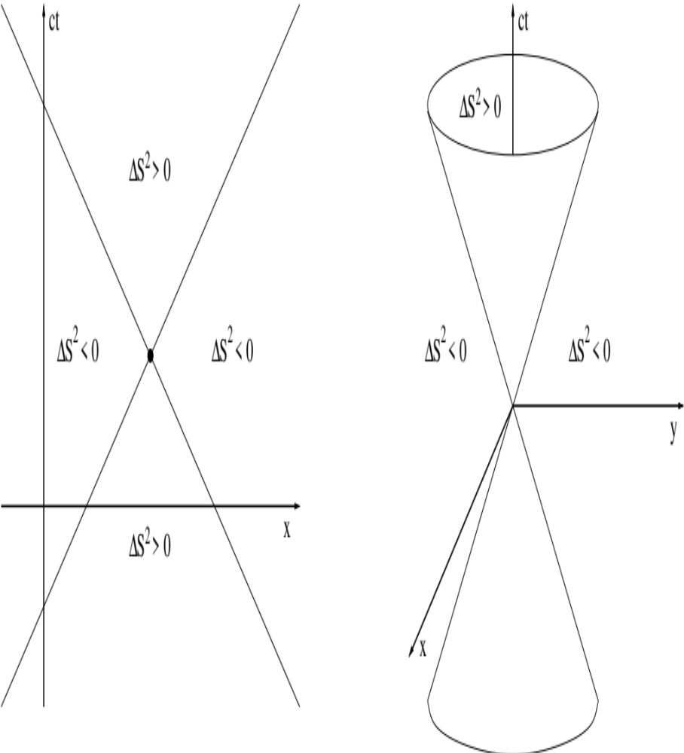
Menti answer
This is false; it looks like this in 1D but space is 3D so there is a lot more “volume” outside the light-cone than inside it
20

Slide 21
Summary of ΔS²
ΔS² > 0 = `Time-like’
  Time order always the same in all frames
  Space order can change between frames
  One frame has Δx = 0
  ΔS² = c²τ² where τ is the proper time
  Causally connected
ΔS² < 0 = `Space-like’
  Space order always the same in all frames
  Time order can change between frames
  One frame has Δt = 0
  Causally unconnected
ΔS² = 0 = `Light-like’
  Time and space order always the same in all frames
  No frame has Δx = 0 or Δt = 0
  Causally connected (by light-speed signal only)
21

Slide 22
Tachyons
In a different frame
ct
x
x
Event 2: I catch the tachyon weight
Event 1: I throw the tachyon weight with speed > c
Event 2: Puppy gets squashed ΔS² < 0
Event 1: Puppy gets squashed
22

Slide 23
What we did today
Introduced four-vectors
  Four components and a lot of similarities to three-vectors
  Saw that the length squared of all four-vectors is constant under Lorentz transformations
Discussed the separation of two events
  The length squared of the four-vector which is the difference of the two events
  The sign of the separation tells us if events are causally connected or not
  Works in all frames if nothing goes faster than c
23

