Slide 1
Year 1 – Relativity
Lecture 7
Paul Dauncey

Slide 2
Overview of lectures
Lecture 1: Introduction, concepts and classical results
Lecture 2: The postulates of Relativity
Lecture 3: Length contraction and simultaneity
Lecture 4: The Lorentz transformations
Lecture 5: Space-time diagrams and world lines
Lecture 6: Four-vectors and causality
Lecture 7: Energy and momentum
Lecture 8: Energy and momentum conservation
Lecture 9: Particle reactions
Lecture 10: The relativistic Doppler effect

Slide 3
Previously on Relativity
Saw events and four-vectors
  Events are points in ct,r space which can also be defined using four-vectors (ct,r)
  Equivalent to three-vectors but with four components
Four-vectors undergo Lorentz transformations
  All three-vectors rotate using the same equations
  Similarly, all four-vectors transform using the same LT equations
  The length-squared S² = c²t² − r² is invariant and so this holds for all other four-vectors also
3

Slide 4
What we will do today
Introduce four-momentum for an object
  Combining energy E and momentum p
  See how these depend on the object speed
Check some of the four-momentum properties
  In the low speed approximation, E and p should correspond to the classical quantities; mu²/2 and mu
  Find the invariant length-squared for the four-momentum
  Rederive the velocity transformation
4

Slide 5
Four-vectors
There are many three-vectors in physics
  Position r, velocity v, momentum p, electric field E…
  All rotate using the same transformation
  There are also three-scalars = invariants under rotations; e.g. time t, energy E, mass m…
  Equations which use these will be rotation covariant
The “four-position” (ct,r) is not the only four-vector
  There are many other four-vectors, all of which combine a three-vector with a three-scalar
  There are also four-scalars = invariants under LTs
  Fundamental physical laws use these to be LT covariant
5

Slide 6
Menti question
Go to www.menti.com
Enter code 31 08 31
Question 1: Every three-vector has an associated three-scalar. Together, these form a four-vector which undergoes Lorentz transformations when changing inertial frames
  True
  False
6

Slide 7

Transforming from rest
Object at rest
Observer frame moving at negative β
Observer frame at rest
Object moving with positive β_{u}=−β
7

Slide 8
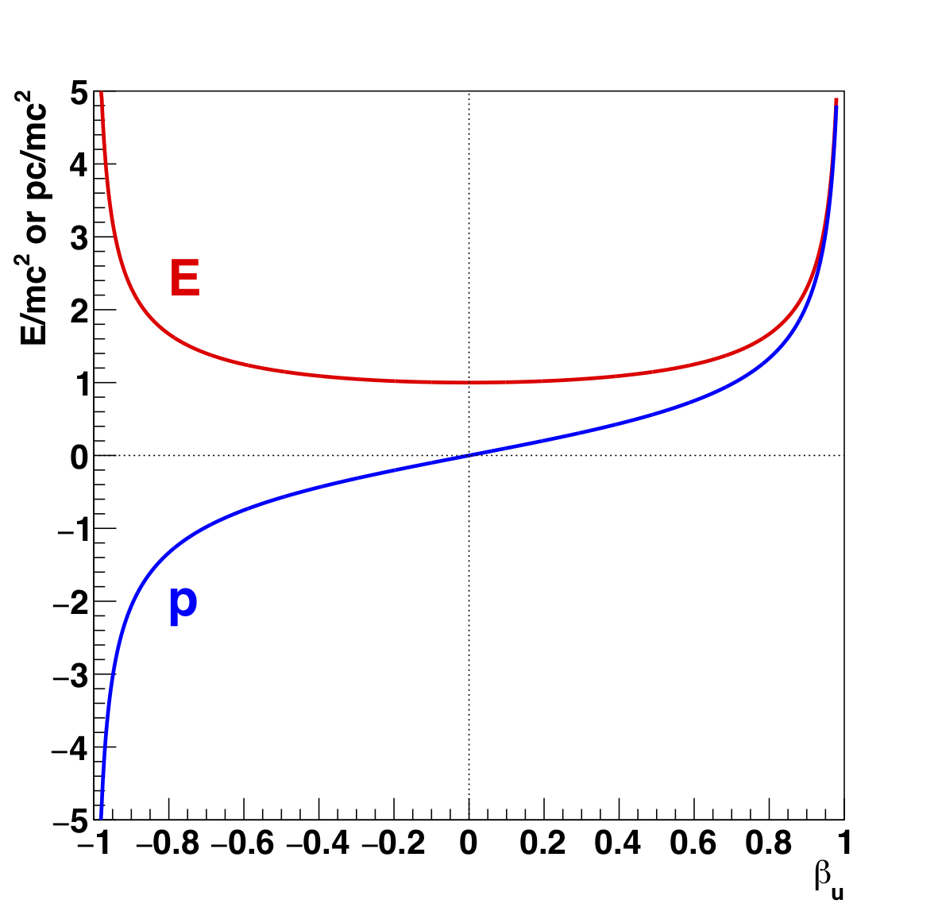
Energy and momentum vs β_{u}
8

Slide 9
Menti question
Go to www.menti.com
Enter code 31 08 31
Question 2: In principle, it is possible to accelerate an object to the speed of light, i.e. to u=c
  True
  False
9

Slide 10
Menti question
Go to www.menti.com
Enter code 31 08 31
Question 3: What are the first two terms in the binominal expansion of (1 − x²)^{−1/2} ?
  1 + x
  1 − x
  1 + (x²/2)
  1 − (x²/2)
10

Slide 11
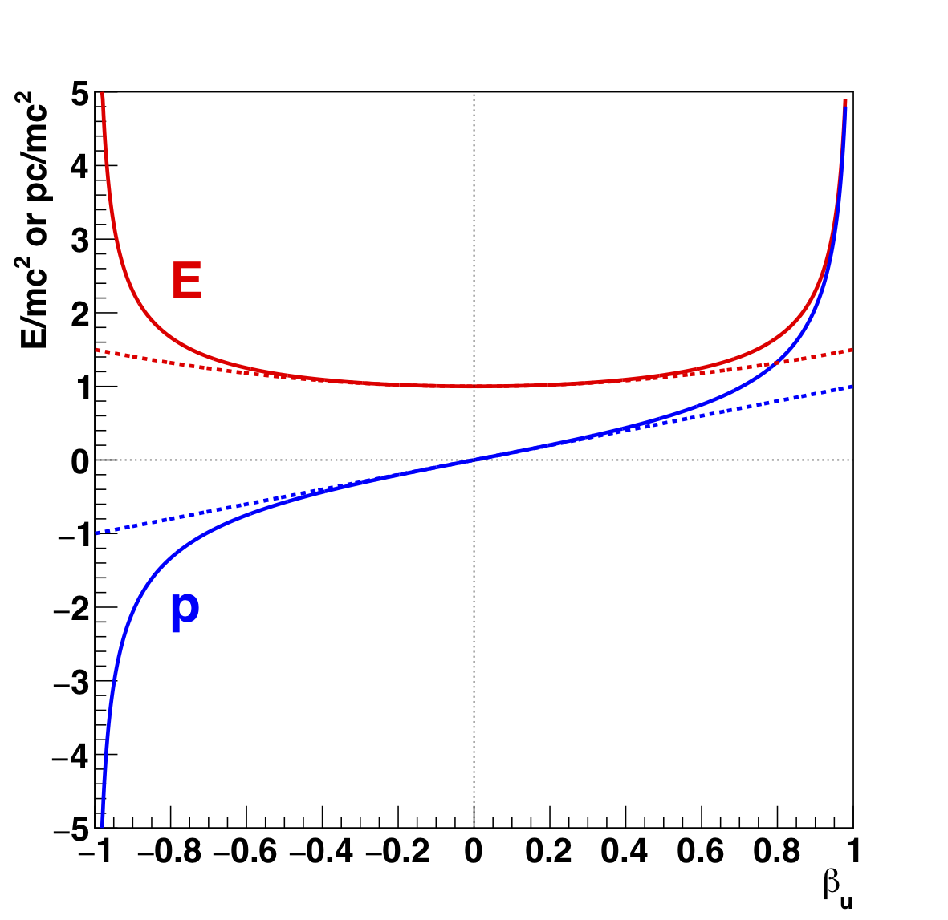
Energy and momentum vs β_{u}
Classical approximations
11

Slide 12
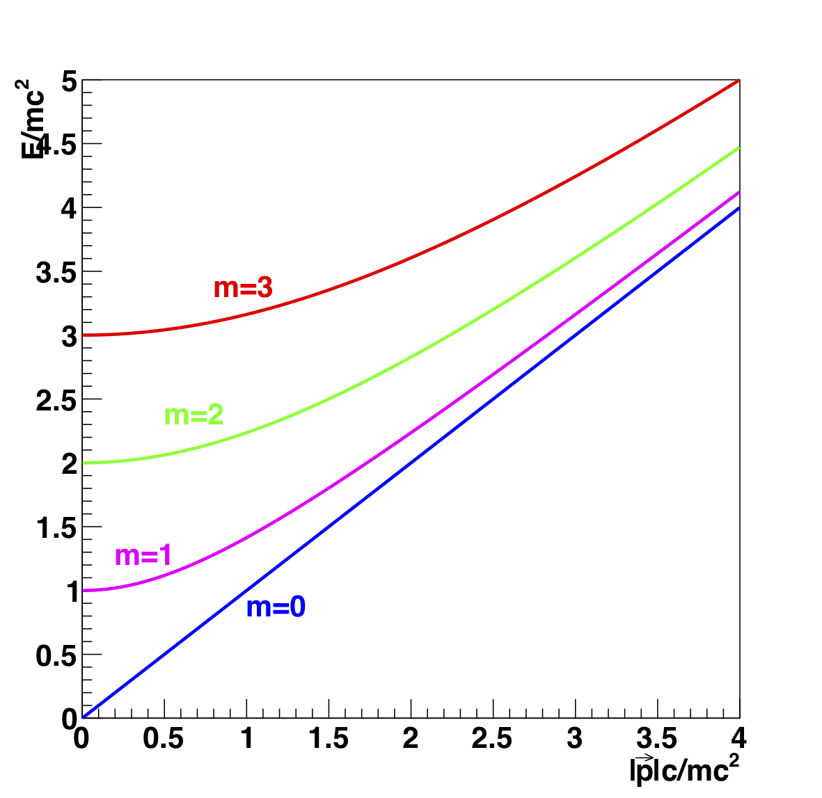
Energy vs momentum
12

Slide 13
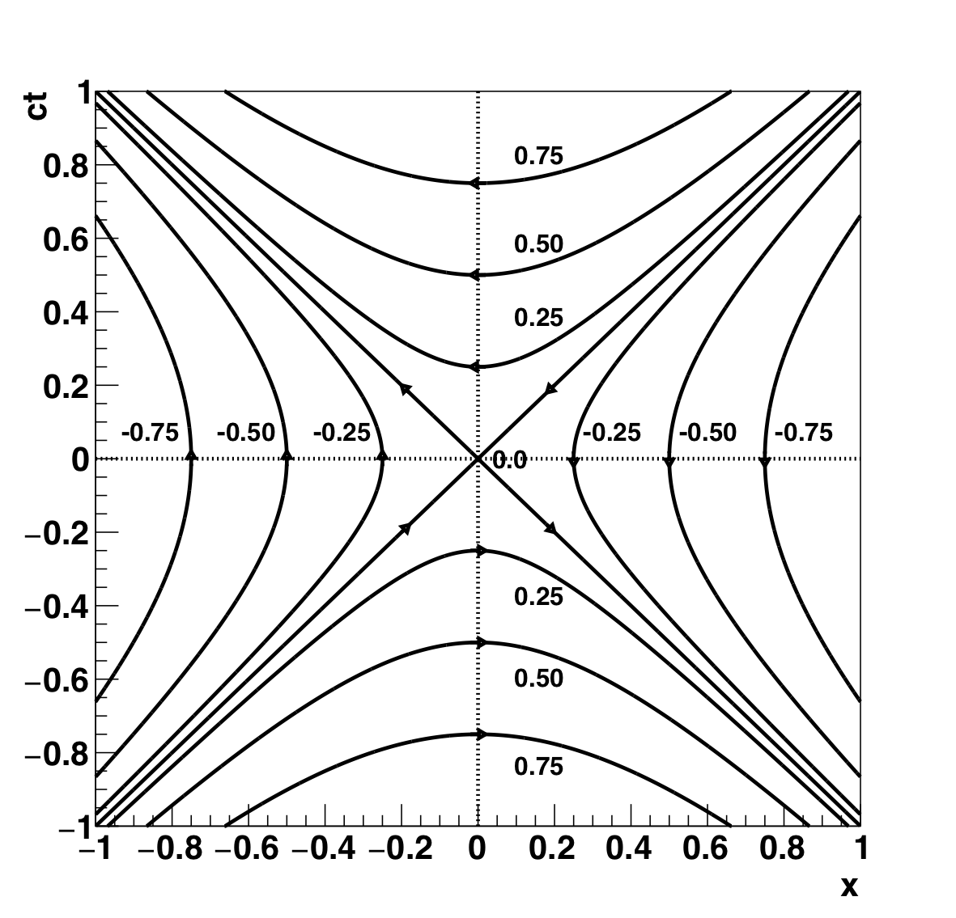
Energy vs momentum
Only top quadrant is relevant as
E > 0 and m is real
13

Slide 14
What we did today
Introduced the four-momentum
  Combines E and p which are functions of velocity
    E = γ_{u}mc², p = γ_{u}mu
  Classical expressions are approximations to exact formulae
  Velocity is given by
    u = pc²/E
  Saw the four-momentum invariant is (mc²)²
14

